Slide 1


INCLUSIVE EDUCATION IN SPAIN: WORK IN PROGRESS
Mercedes Mayoral
Psychologist
Master's Degree in General Health Psychology
Postgraduate Expert in ADHD, Learning Disorders and Behavioral Disorders
European Dyslexia Association
Catalan Dyslexia Association
Most, Czech Republic, March 21st 2024

Slide 2

Conflicts of Interest Statement
Regarding this presentation, there are no relationships that could be perceived as potential conflicts of interest.
The intervention that I submit has NOT been financed, totally or partially, by any company with economic interests in the products, equipment or similar mentioned in the same.

Slide 3
My journey…
Catalan Dyslexia Association
European Dyslexia Association
Inclusive education in Catalonia

Slide 4
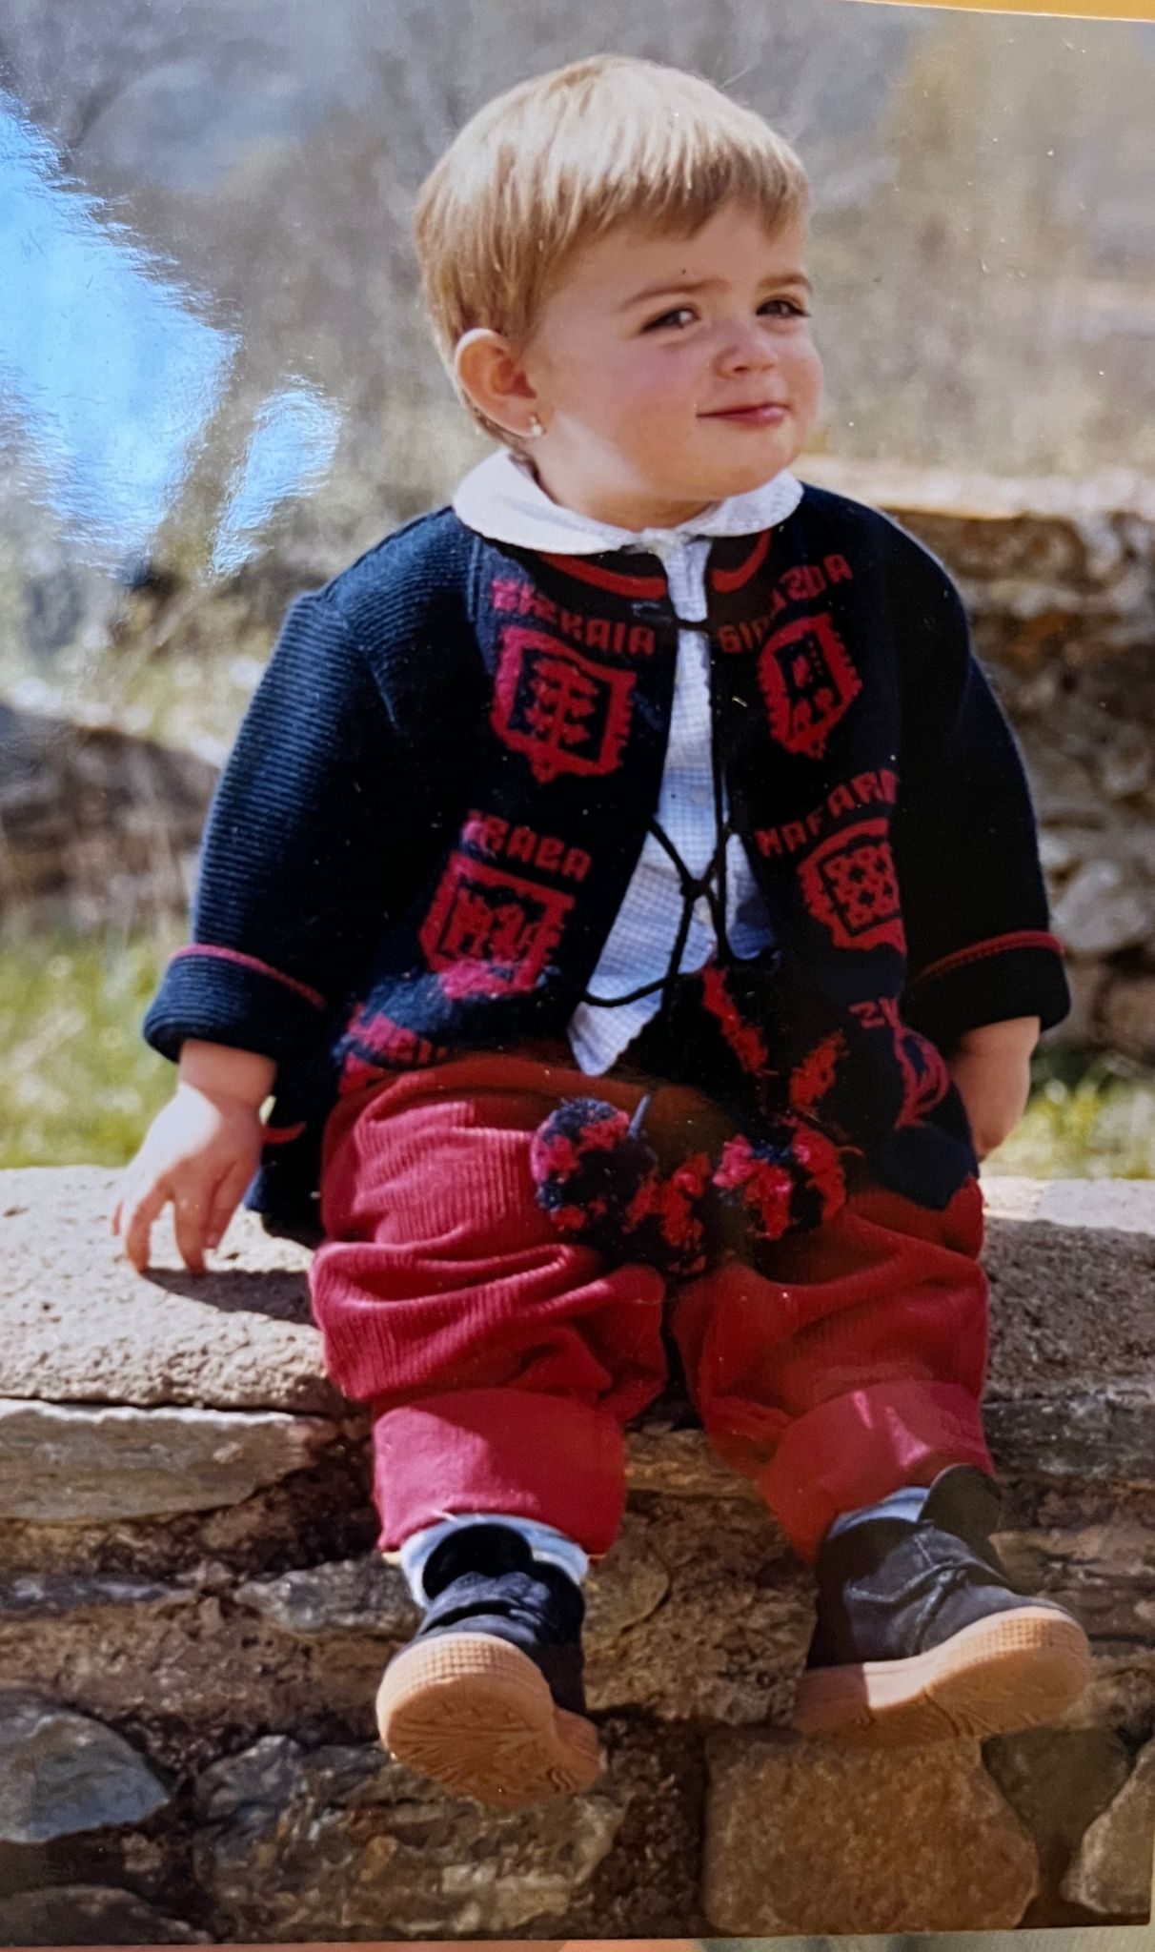
1.
My journey…

Slide 5
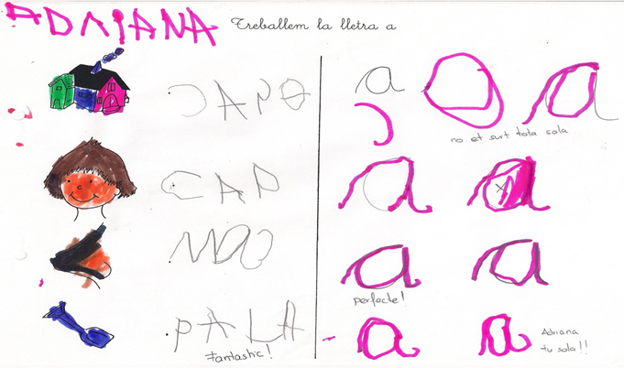

Slide 6
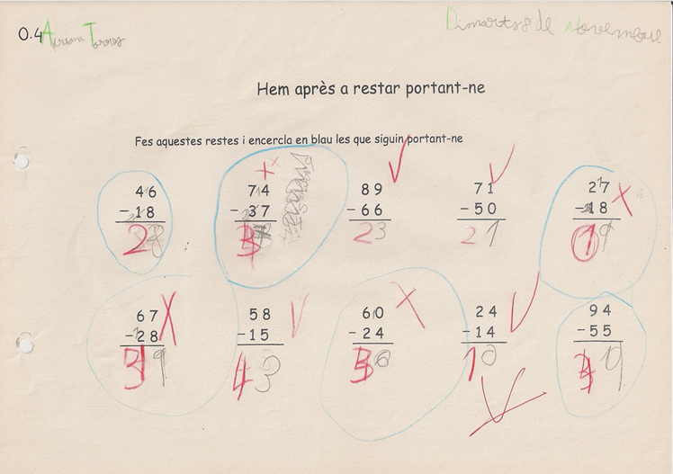

Slide 7
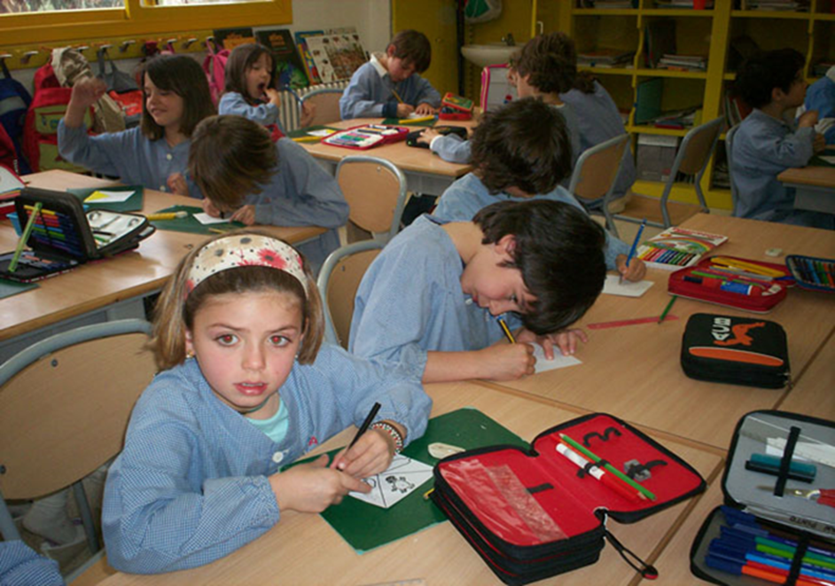

Slide 8
2. Catalan Dyslexia Association

Slide 9
Founded in 1992: 32 years!!!
First association in Spain
480 members
More than 1800 consultations per year

Slide 10
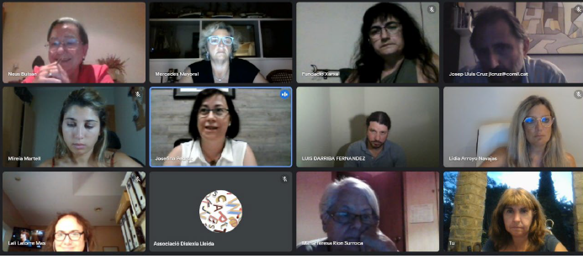
Board of directors

Slide 11
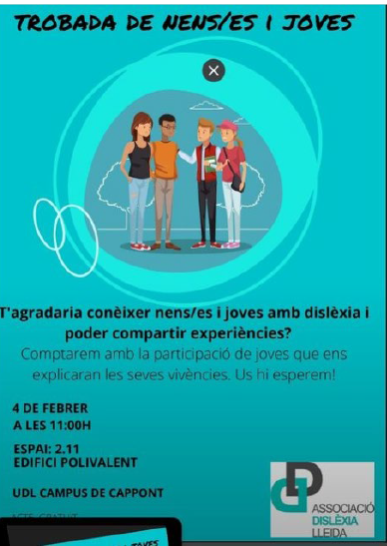
Around 20 meetings with schools per year

Slide 12
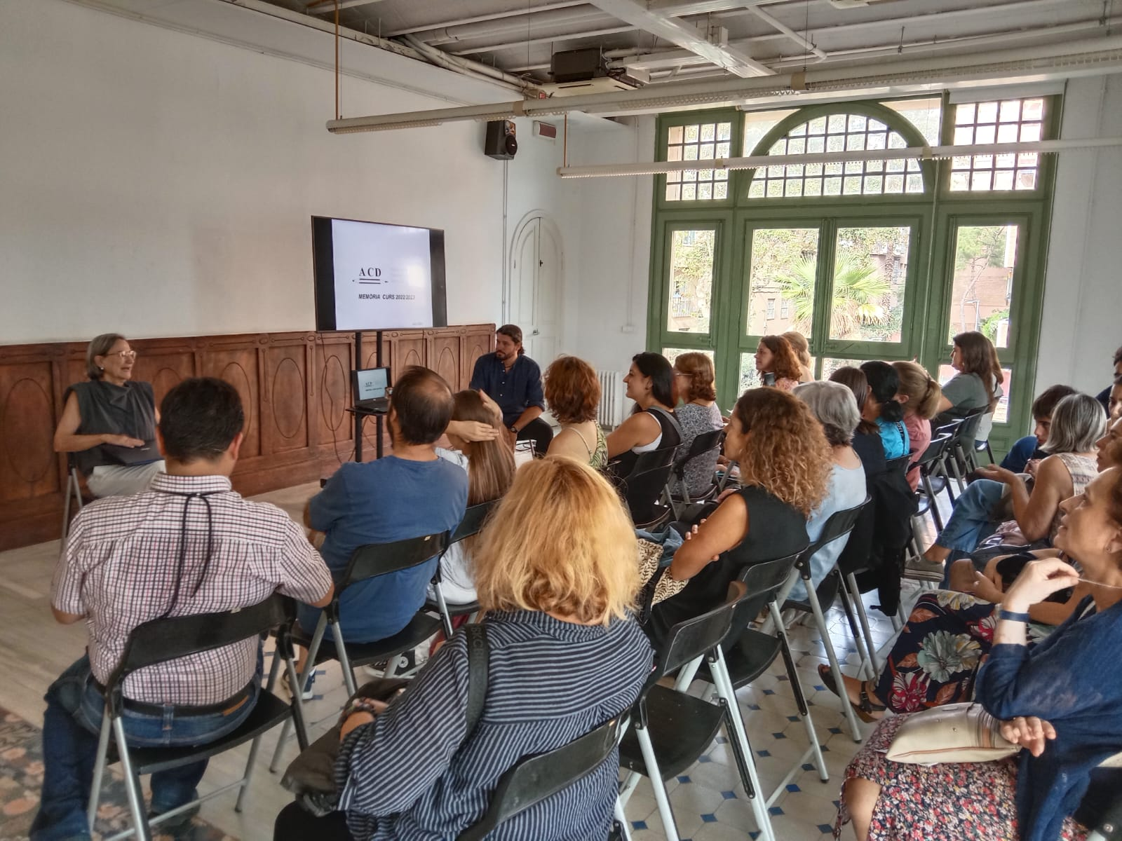
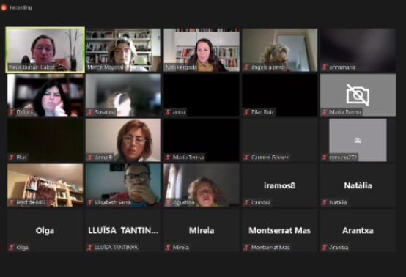
Two monthly meetings with families

Slide 13
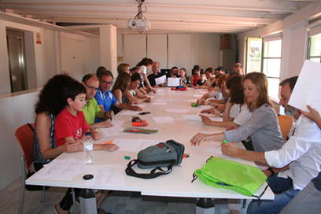
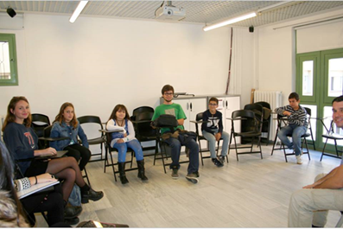
And families with children

Slide 14

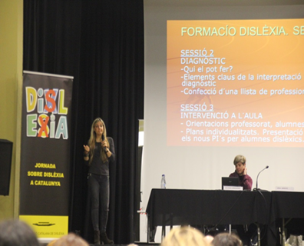
Every two years:
“Jornada sobre la Dislexia”

Slide 15
Course: “Introduction to the Knowledge of Dyslexia”
8th edition

Slide 16

Continuing education for professionals

Slide 17
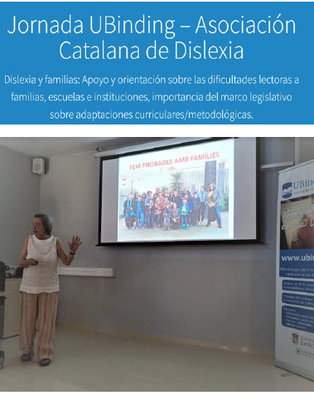
Collaboration with universities

Slide 18
Research

Slide 19
Lobbying

Slide 20
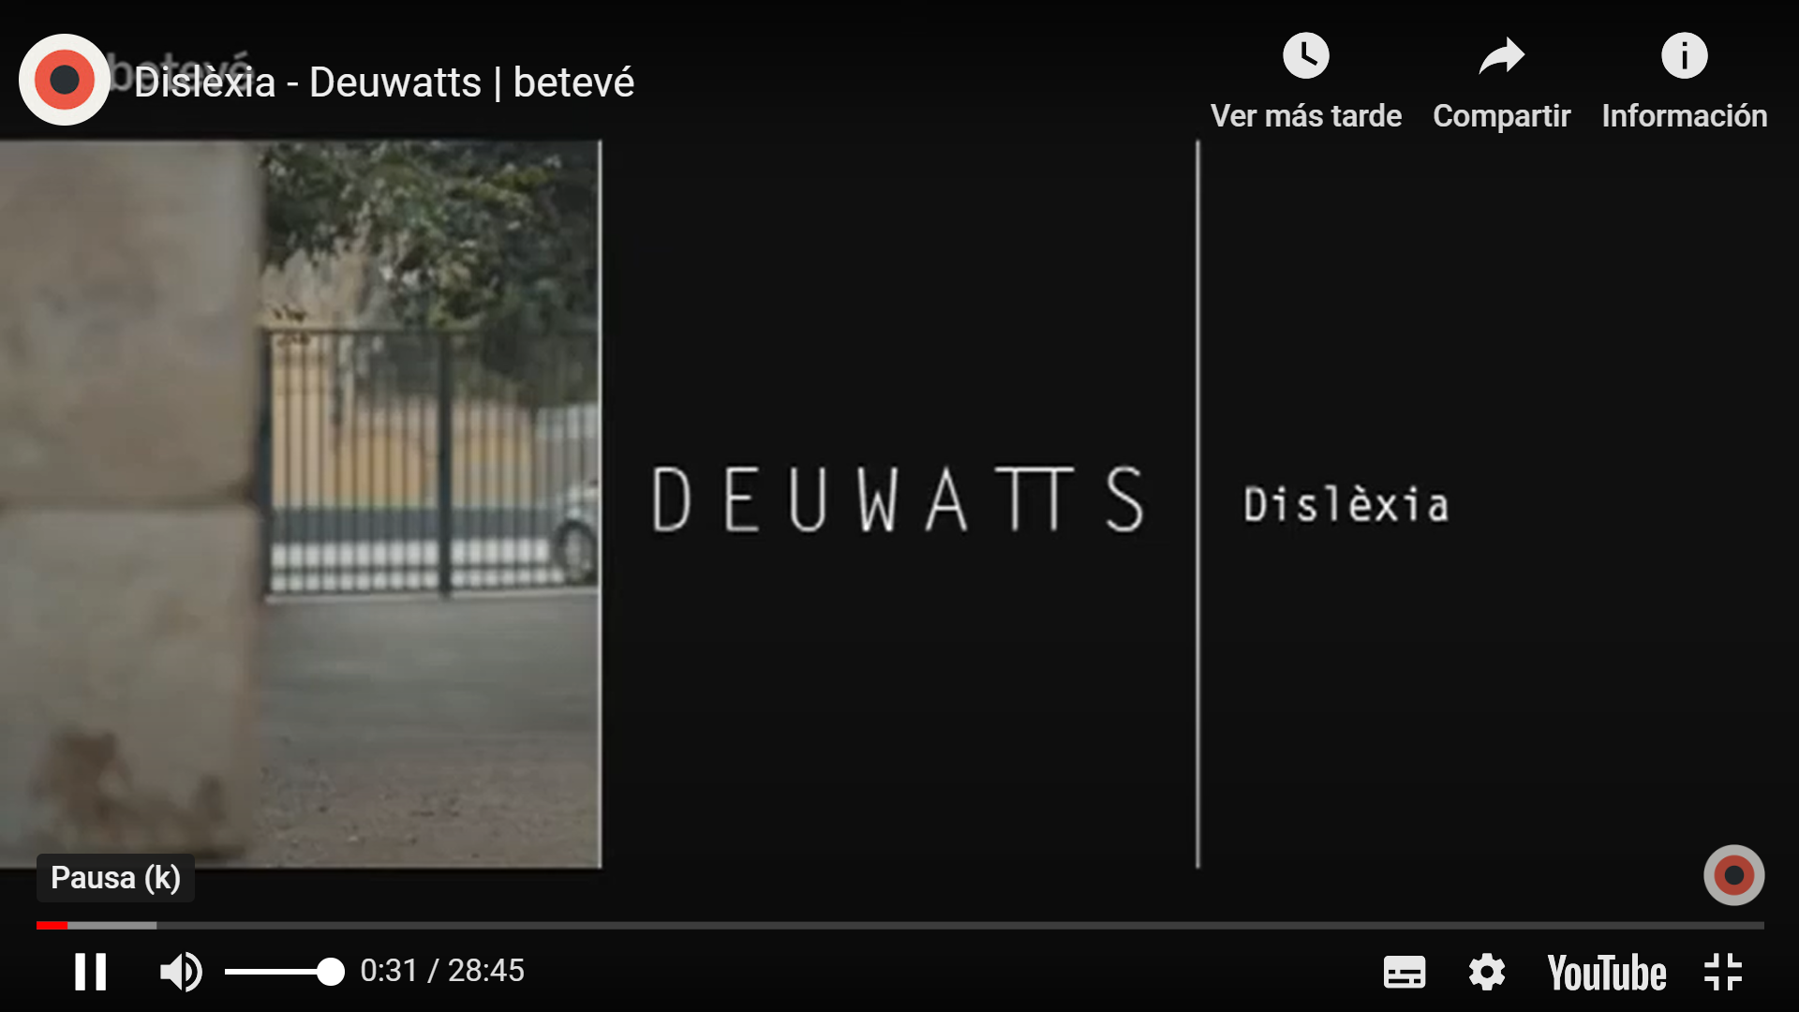
Contacts with the Media

Slide 21


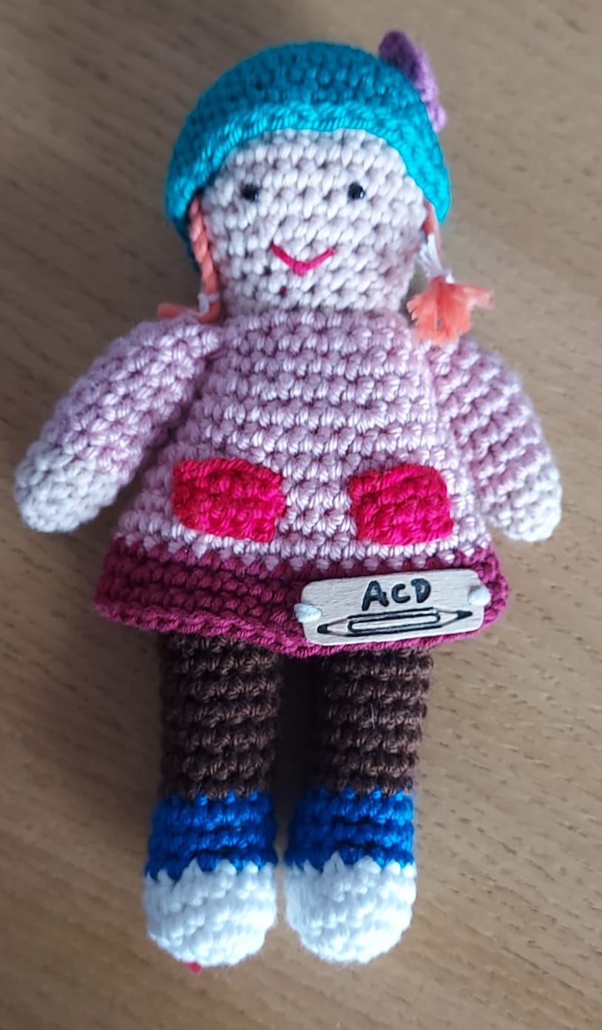
Books and materials

Slide 22
2. European Dyslexia Association

Slide 23

European non-governmental umbrella organisation
Regional and National Effective Members in 21 EU countries plus Switzerland, San Marino, Turkey and Norway and Adherent member organisations
40 member organisations in 25 European countries

Slide 24
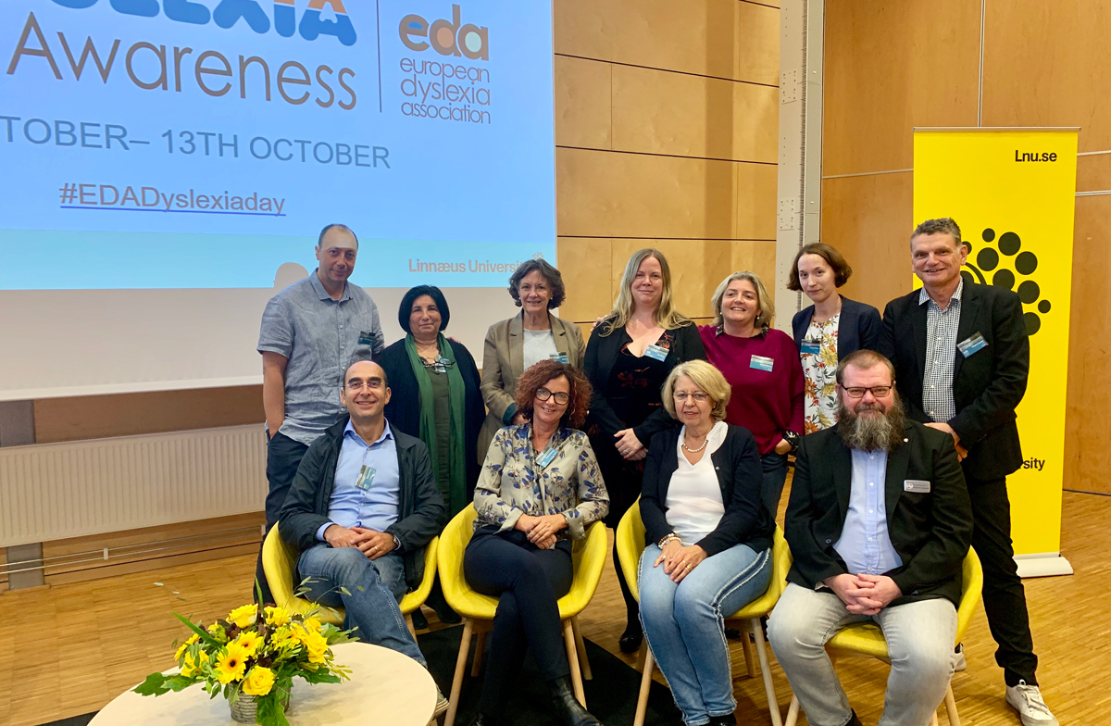

Slide 25
OUR VISION
Every child and adult with dyslexia (and/or DYS-differences) in Europe has the right to access and to receive appropriate support and opportunity to achieve their full potential in education, training, employment and life.
OUR MISSION
To facilitate the exchange of information and good practice through international networking and lobbying.
In partnership with its member organisations, the EDA will challenge prejudice and ignorance to ensure that people with dyslexia are empowered to reach their full potential.

Slide 26

FORESIGHT: FLOURISH TOGETHER: FrOm leaRning disabilitiES to new Inclusive teaching in hiGHer EducaTion
SASLED: Sports activities for people with specific learning disabilities
Dyslexia@Work.EU
Neurodiversity At Work
Maths4All
OTHER PROJECTS:
Dyslexia International Course
Dyslexia Members Survey

Slide 27




Slide 28


Slide 29


Slide 30
4. Inclusive Education in Catalonia

Slide 31
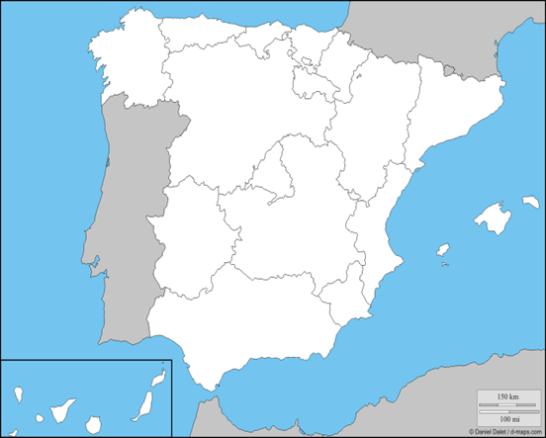
Spain is a state made up of 17 autonomous communities and two autonomous cities:
Ceuta and Melilla.

Slide 32
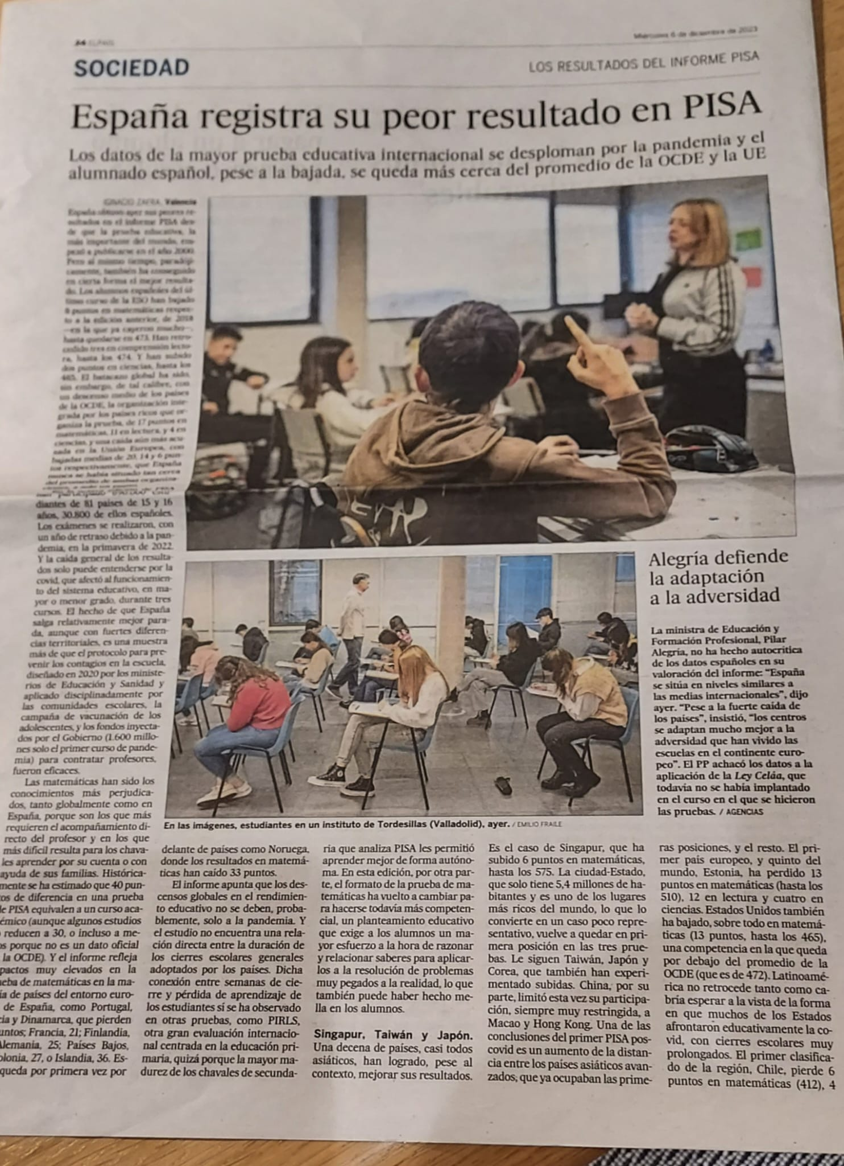
“Spain registers its worst result in PISA
The data from the largest international educational survey plummets due to the pandemic and the Spanish student body, despite the drop, remains closer to the OECD and EU average”
El País, December 8th 2023

Slide 33
8 educational laws in 46 years of democracy: 1 new law every 5’75 years
Each government, its own, sometimes even before the previous norm - of a different political nature - had been fully implemented.
LOMLOE (2020)
Inclusive education as a fundamental principle.
The principles of Universal Design for Learning (UDL) will be applied.

Slide 34
LOMLOE (2020)
Ley Orgánica 3/2020, de 29 de diciembre, por la que se modifica la Ley Orgánica 2/2006, de 3 de mayo, de Educación.
CENTRAL GOVERNMENT:
General organization of the educational system
General programming
Minimum education
Regulation of the conditions to obtain an academic degree
High inspection
AUTONOMOUS COMMUNITIES:
to exercise their statutory powers in matters of education and development of provisions of the LOMLOE.
Notes:
Corresponde a las comunidades autónomas ejercer sus competencias estatuarias en materia de educación y desarrollo de disposiciones de la LOMLOE

Slide 35
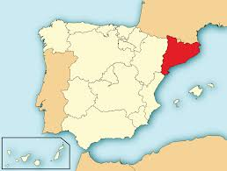
Catalonia:
8.005.784 inhabitants
16,5% of the total population of Spain
2 languages:
Catalan
Spanish

Slide 36
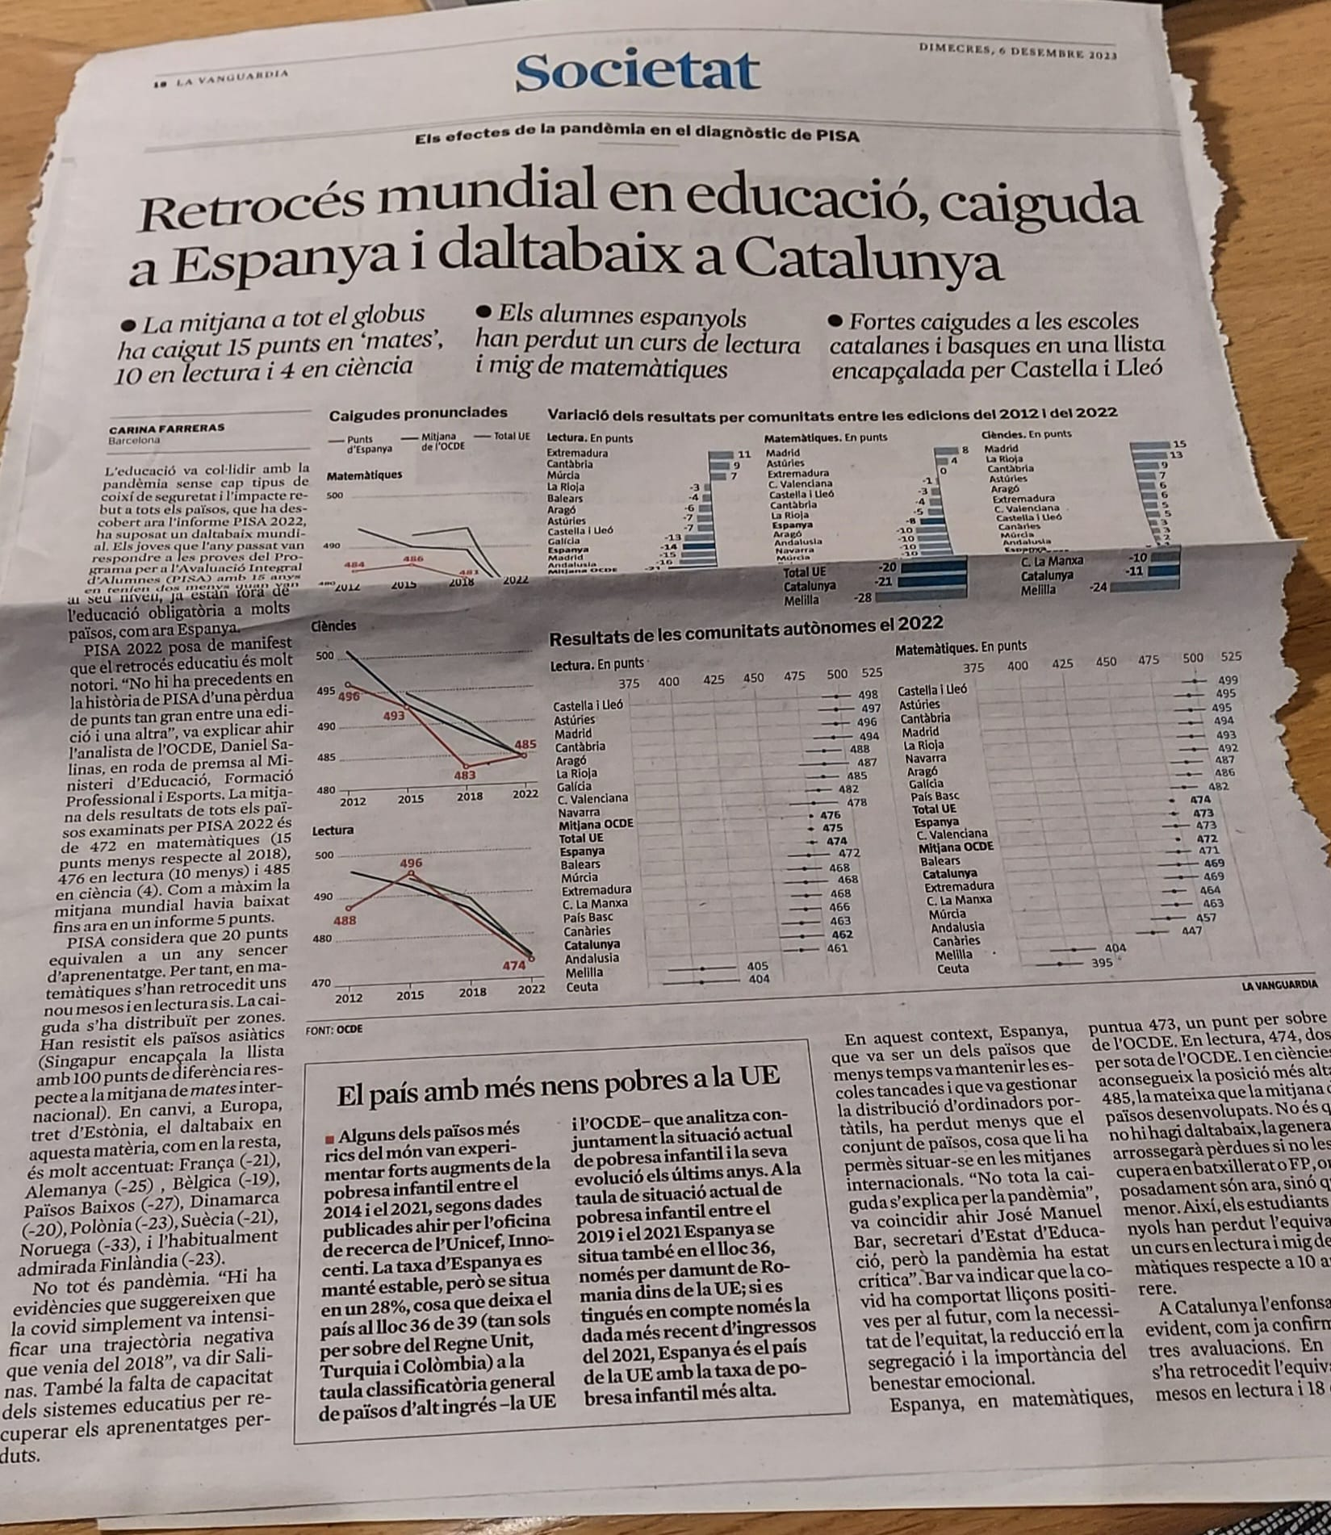
“Global setback in education, fall in Spain and disaster in Catalonia”
La Vanguardia, December 6th 2023

Slide 37
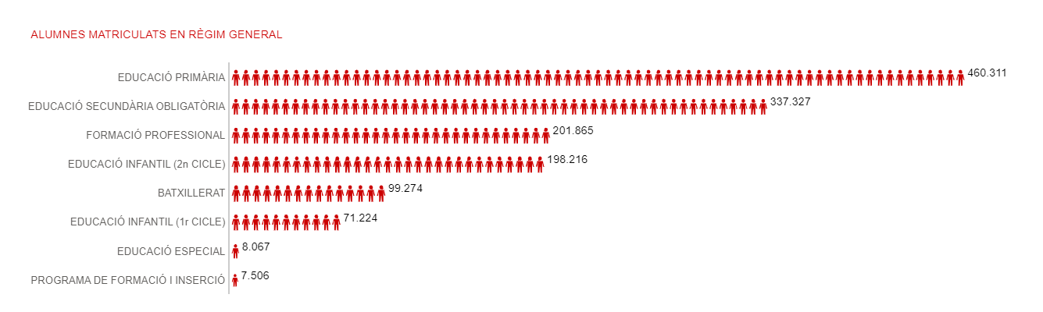
Total number of students: 1.384.328
Source. Dept. of Education, Catalan Government, 2022

Slide 38
Year | Students with Special Educational Needs (SEN) in ordinary schools | Students in Special Education Centers | Total students with Special Educational Needs | Percentage of students with Special Education Needs in ordinary schools
2005-2006 | 15.795 | 6.779 | 22.574 | 70%
2010-2011 | 18.407 | 6.369 | 24.776 | 74.3%
2015-2016 | 18.625 | 7.282 | 25.907 | 71.9%
2020-2021 | 29.028*** | 7.818 | 36.846 | 78.8%
*** New categories of SEN were added along the years
Source: Department of Education. Government of Catalonia

Slide 39
Specific Educational Support Needs
A Student with Specific Educational Suppport Needs…
  Requires a different educational attention from the ordinary one due to special educational needs: Specific Learning Difficulties, ADHD, High Intellectual Capacities, Gifted and Talented youth,
  for having joined the educational system late or for personal conditions or school history.
A Student with Special Educational Needs (SEN)
Requires specific support and educational attention derived from disability or serious behavior disorder:
Physical disability, Intellectual disability, Sensory disability (visual, auditory), Autism Spectrum Disorder, Severe Behavioral Disorder, Mental Disorder, or Severe Degenerative Diseases and Rare Diseases
Psychopedagogical Evaluation Report + NEE Expert/technical Opinion

Slide 40
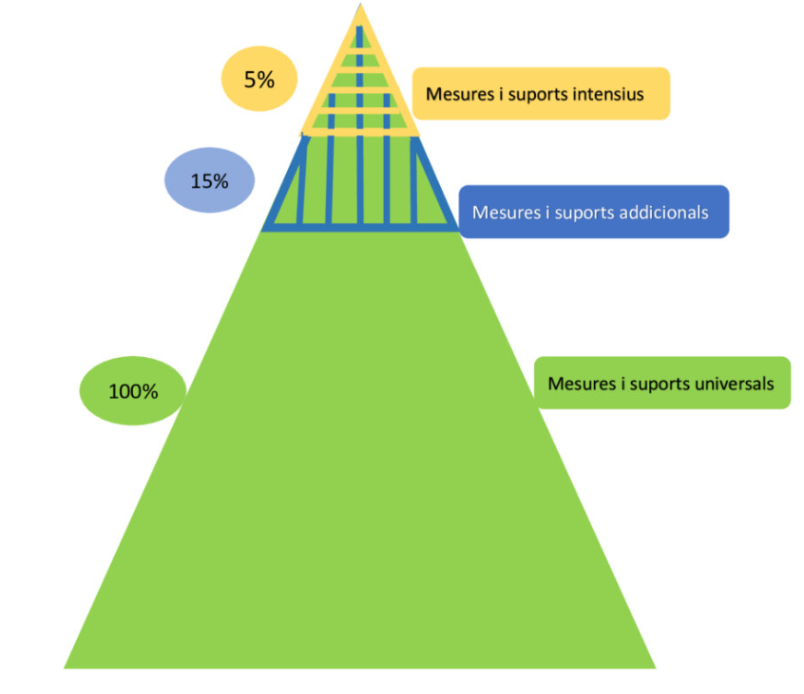
Intensive Measures and Supports
Additional Measures and Supports
Universal Measures and Supports

Slide 41
Universal measures and supports:
Personalization of learning
Flexible organization of the center
Formative assessment
Educational orientation and tutorial action
…
Additional Measures:
Support from the special education or hearing and language teacher or guidance counselor
Support from teachers and care staff for inclusive education
Personalized school support
Curricular diversification programs
Reception classrooms (Aules d’Acollida)
Teaching units in juvenile justice centers or the Directorate General for Child and Adolescent Care (DGAIA)
Hospital classrooms
Day hospitals for teenagers
Home care
…

Slide 42
Intensive Measures and Support:
Intensive support for inclusive schooling (SIEI)
Intensive Hearing and Language Support (SIAL)
Special education centers (CEE)
Special education centers providers of services and resources (CEEPSIR)
Comprehensive support classrooms (AIS)
Shared schooling units (UEC)
New Opportunities Programs (NPOs)
Educational care staff support
Educational resource centers for the hearing impaired (CREDA)
Educational resource centers for the visually impaired (CREDV)
…

Slide 43

The Catalan Ombudsman Office:
Inclusive Education in Catalonia.
September 2021

Slide 44
Structural obstacles:
1.Lack of cultural paradigm shift in professional practice
2.Deficits in the alignment and co-responsibility of the different actors involved
3. Insufficient resources

Slide 45
Deficits in the implementation of the inclusive education model:
Schooling in specialized centers
Intersectionality
Admission to ordinary schools
The detection and evaluation of specific educational support needs
Schooling conditions and the provision of resources in ordinary schools
Networking and coordination between educational centers and services
Educational trajectories: participation in lifelong learning
Access to education beyond school

Slide 46
Recommendations:
The promotion of a cultural paradigm shift in professionals and families
The alignment of the different actors involved
The improvement of the provision of resources
The participation of children and adolescents with specific educational support needs in educational leisure

Slide 47
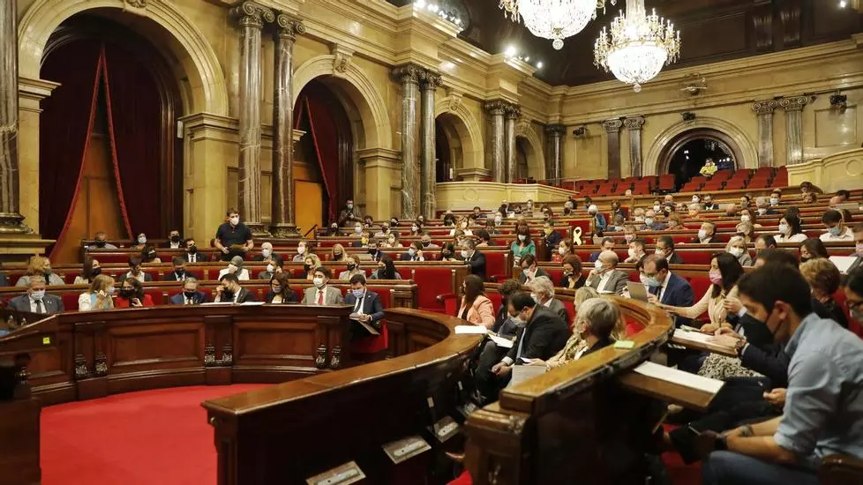
Study Commission on the
Deployment of an Inclusive Education System
Catalan Parliament.
23 Nov 2023

Slide 48
Measures to achieve equity in the system and to improve the attention of students with educational needs during school and non-school hours:
Focusing on the individual needs of the student
Improve:
  Early Detection and Assessment of Special Educational Needs
  Psycho-pedagogical advice and guidance
  Reception Protocols at centers and transitions
  Teacher Support

Slide 49
All ordinary centers must welcome and integrate all diversity with an equitable distribution and resources must be provided.
Provision of trained teaching and non-teaching staff to accompany Specific Educational Support Needs.
Possibility of part-time schooling in ordinary and special education centers
The decision about where to school children with Special Educational Needs must be taken with the family (Contradictory decrees)
Increase in school dropout rates for children with SEN
Decrease in the graduation rates of these children.
The complete itinerary must be guaranteed.

Slide 50
Measures to support the pedagogical work of teachers and to coordinate the actors involved:
Ratio reduction
Cooperation between professionals, families and administration
Important lack of teachers and professionals: psychologists, psychopedagogues, specialists in special education, school nurses
Training and support programs for teachers
Expand the staff of the Counseling and Psychopedagogical Guidance Teams (EAPS)
Improve coordination between Child development and early care centers (CDIAP) and Child and youth mental health centers (CSMIJ)

Slide 51
Need for a paradigm shift:
Training programs for teaching and support staff in the inclusion model focused on the student's abilities and attention to diversity
Research plans in educational innovation and transformation
Evaluation systems for the deployment of the inclusive school
Need for a budget increase of 100 million Euros to improve diagnostic and treatment care

Slide 52
Still a long way to go

Slide 53
Děkuji za pozornost
Thank you for your attention
Mercedes Mayoral, mmayoral@grupomayo.es
European Dyslexia Association mercedes.mayoral@eda-info.eu
Catalan Dyslexia Association contacta@acd.cat

