Slide 1
Pindstrupskolen – a Danish example of a collegial support centre
Supervision and guidance for teachers in state schools – case examples from a school in Denmark

Slide 2
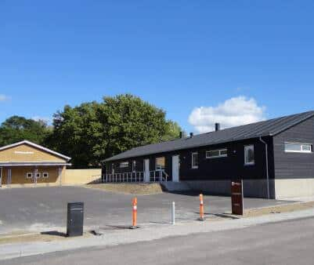
Pindstrupskolen in Denmark
A school for children with autism, ADHD and multiple impairments
We are situated in a commune with 4000 pupils in its schools
112 of them are pupils in our school
The rest are included in the 10 state schools within the commune

Slide 3
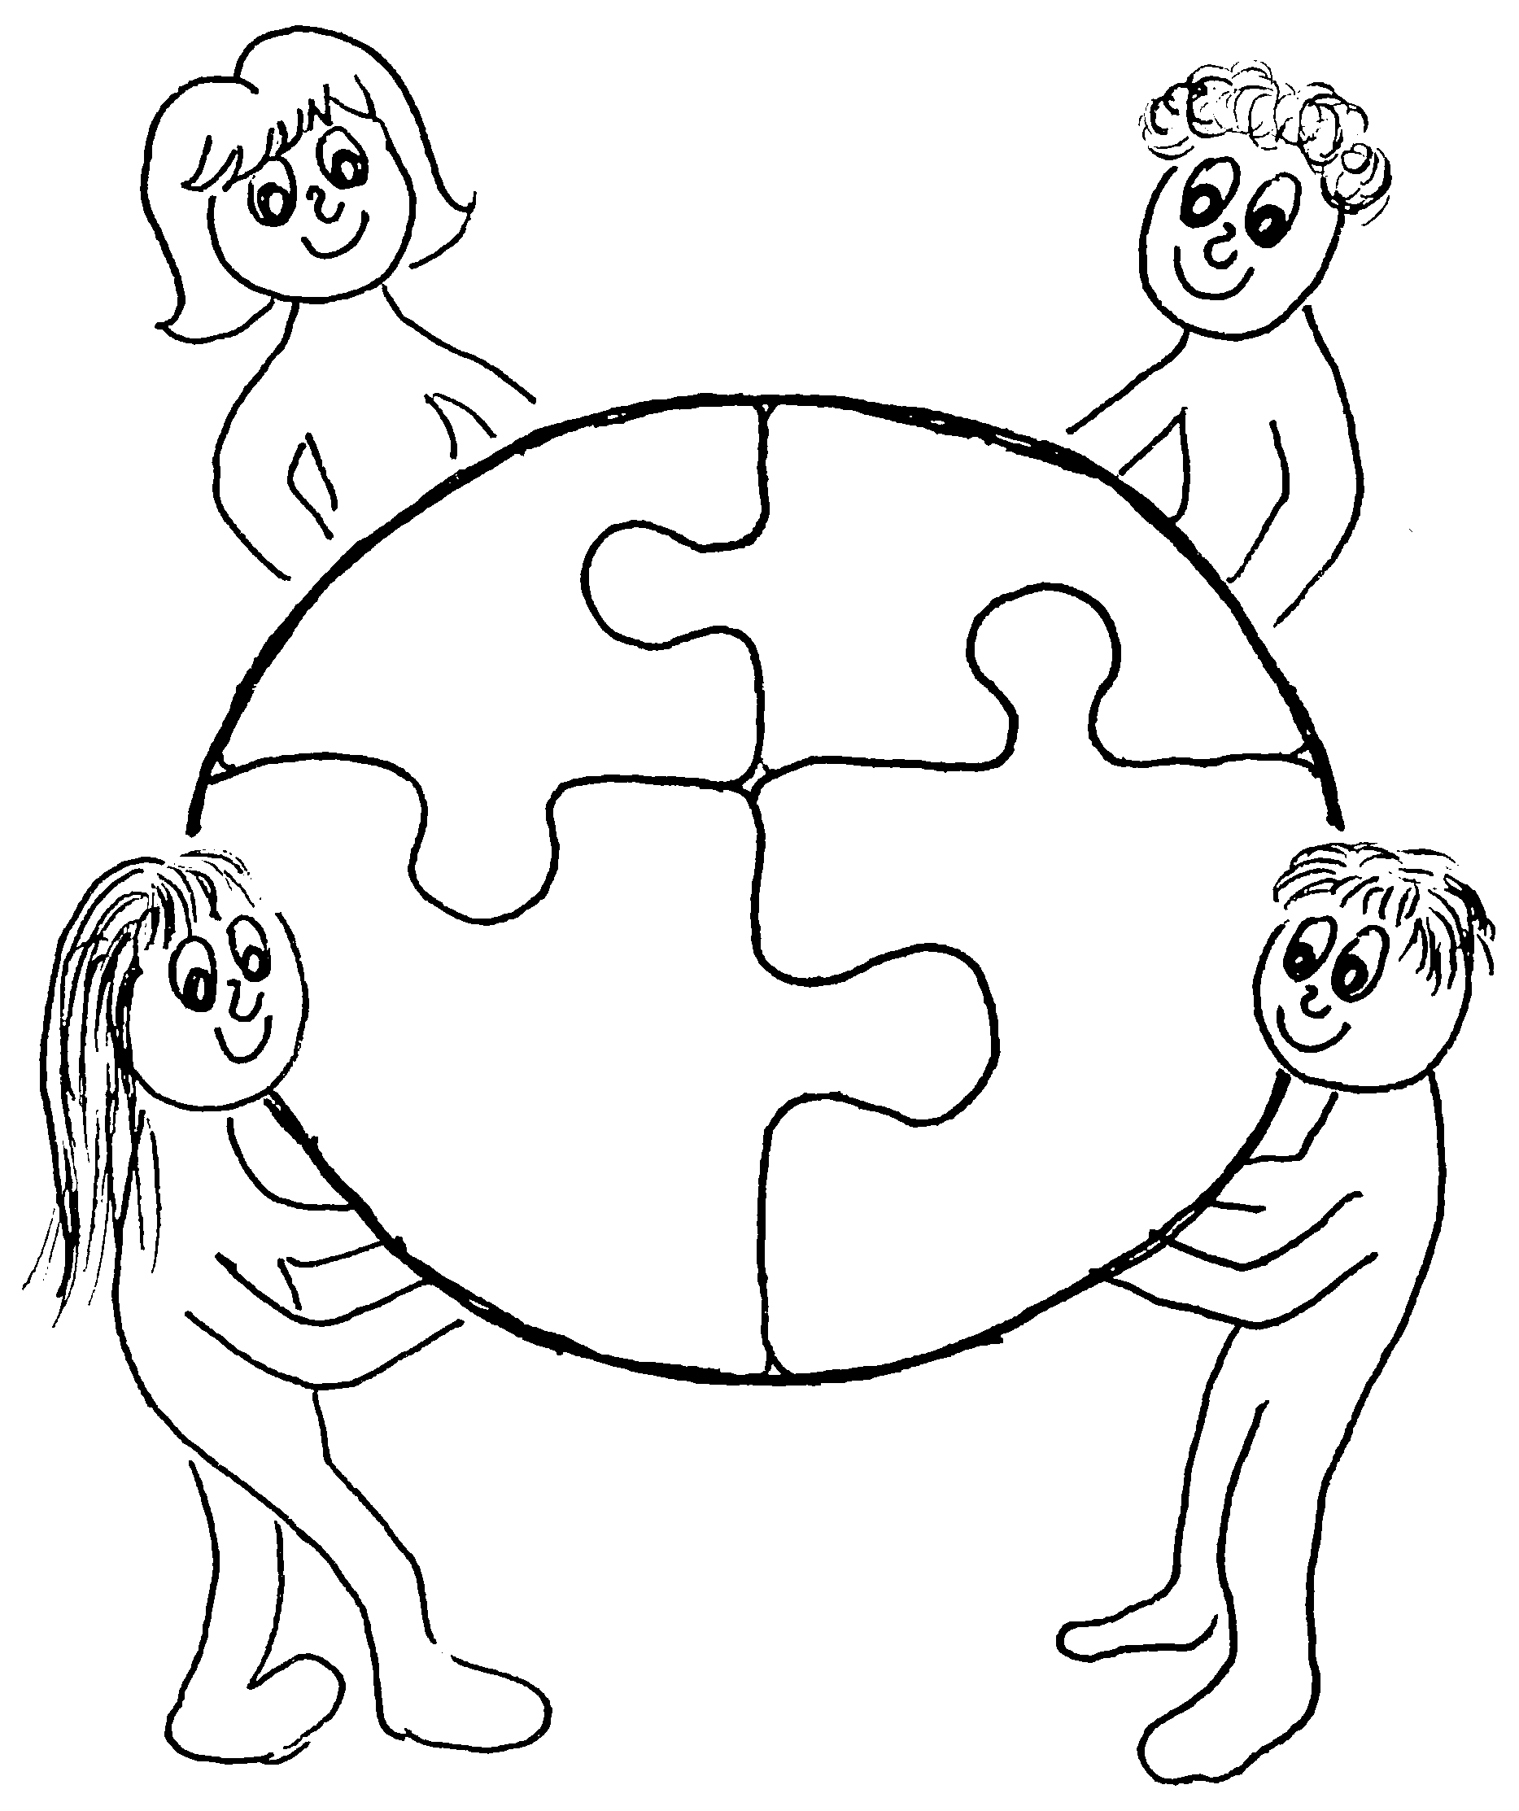
How it all started with a vision
We wanted to help our collegues in state schools
We could see the number of pupils sent to our school rise and we could see that our colleagues in state schools struggled to meet all the different kinds of needs the students in one single classroom had.
We wondered if our understanding and knowledge of how to meet and understand children with special needs could make a difference.

Slide 4
The first years of collegial support
So we started it up and within the first years we offered collegial support through:
Observations and guidance in state schools
Presentations about children with special needs – knowledge about different diagnoses
Workshops about special education, classroom management, visible support systems etc.

Slide 5
We learned that:
We needed to find a way to take our different possibilities and terms into consideration when we gave guidance.
At a school for children with special needs you typically have better terms of, for example, shielding a child.
If a child has a need to be shielded from sensory inputs, you can often find a quieter room at our school than you can typically provide in a state school
So therefore we invented the following approach in which we learn to investigate and learn together

Slide 6
Situated collaborative learning
The learning that can occur when two perspectives meet in practice:
Within our school we are trained in, and have the knowledge of, how to teach children with special needs.
The state schools are trained in, and have knowledge of, classroom teaching at their school and they know which resources are avaiable at their school.
When you combine those two understandings in practice new understandings can arise

Slide 7
Situated collaborative learning
We provide our help to state schools in two ways:
Pedagogical supervision
Our consultants who have a masters degree or a university degree in special education give the teachers pedagogical supervision.
Co teaching
Our teachers or pedagogues go into the state school to work alongside the schools teachers in their classrooms in an apprenticeship type learning.

Slide 8
Pedagogical supervision
Our consultants typically follow this procedure:
They have a meeting with the principal at the school who asked for help. After this meeting they write up a purpose for the supervision.
They arrange a meeting with the staff that work with the chosen challenge to adjust and coordinate perspectives on the chosen challenge.
Then the consultants make observations surrounding the classroom and the students concerned.
Another meeting is set up with the staff where the consultants present their observations. This meeting results in new approaches to try out in the classroom and a new date for a follow up meeting is arranged.
At the follow up meeting the staff present what the approaches have led to – good and bad. We provide supervision, discuss adjustments and, if need be, plan a new date for another meeting.

Slide 9
Co teaching
The procedure is:
The school which asks for help describes their challenge.
Our consultants evaluate and find a teacher at our school with the relevant skills and knowledge for that exact challenge.
Our consultants arrange a meeting with the staff that work with the chosen challenge to aldjust and coordinate perspectives on the chosen challenge and to agree on when and how long our teachers will participate in their classroom.
It is vital that the teachers from our school and the teachers with the challenge have time to reflect and prepare for future teaching together.
When our teachers are in the classroom alongside the state school teachers, new insights can occur and they can learn from each other.

Slide 10
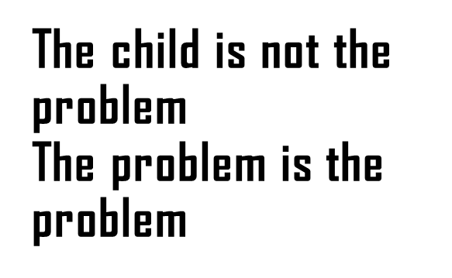
What kind of challenges do we most often meet in state schools?
Approach and understanding of the children.
The child is often seen as the problem, that needs to change – and not the environment/-classroom/way of teaching etc.

Slide 11
What kind of challenges do we most often meet in state schools?
He reacts and acts out so easily
Children with special needs get stressed more easily and when they get stressed, parents and teachers get affected by that stress. It is a visious circle that needs to be broken.
The child is stressed
Parents get stressed
Teacher gets stressed

Slide 12
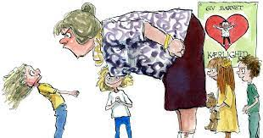
What kind of challenges do we most often meet in state schools?
Inappropriate actions must have a consequence.
Teachers worry about what other students/teachers/parents think if they do not set up consequences.

Slide 13
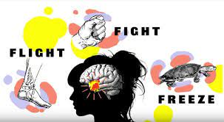
What kind of challenges do we most often meet in state schools?
How to react in a conflict.
When a child is having a stress reaction and is very highly aroused, we need to stay calm.
In this situation we can´t expect to reason with the child and change the behavior – we can only manage the behavior.

Slide 14
Thoughts from a school Principal
Thorsager School – a small village school with students from kindergarten to 6 th grade. (6 - 12 year olds)
We have learned from our cooperation with teachers, pedagogues and consultants from Pindstrupskolen.
Our colleagues from Pindstrupskolen have become a part of our ”pedagogical toolbox”. We rise up to view through a helicopter perspective and find new pragmatic pedagogical solutions together and we try the new approaches and ideas together.

Slide 15
What was the goal? Words from the Principal:
We needed to change the narrative around the children who were considered problematic.
We needed to start believing that children are cooperative and will always try to do the right thing – if they are able.
We needed to enhance and grow, with a new perspective and understanding of the children with special needs

Slide 16
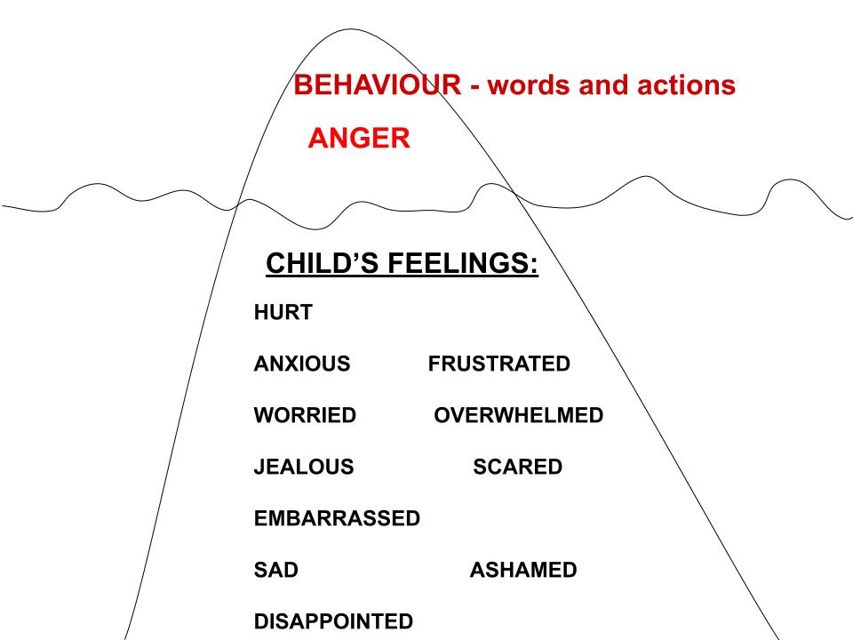
Workshop about an appreciative and inclusive approach
We held a workshop about these challenges.
The staff learned about the challenges these children have – they might not be visible but lie beneath the surface.
And through that, staff understanding, and ways of meeting the children, changed.
The staff learned tools and were able offer the children more help and empathy.

Slide 17
Another case example:
A girl who often acted out when she was stressed. The teachers guided the girl out of the classroom using force.
After our guidance
The teachers have the other children leave the classroom
They now find that the girl calms down quickly when they leave the room. And the other children understand that when she feels like this, they need to leave her alone.
And they also find that because she does not get angry and hurt the other children, it is easier to protect the social connections between her and the other children

Slide 18
An example of co-teaching:
In a class where several students had difficulty being in this large group of students, a high level of stress had been generated in the classroom culture over a longer period of time.
A co-teaching course with a teacher from Pindstrup School strengthened (with a low-arousal approach) the teachers work with the class to find calm and to generate calm in the group of children and around the children.

Slide 19
Thoughts from a school Principal
Roende School – a larger village school with students from kindergarten to 10th grade. (6 - 16 year olds)
We have a rewarding and educational collaboration with Pindstrup School
The staff at Roende School express that they are now better qualified to work with children with special needs

Slide 20
Thoughts from the Principal of Roende school
We can mention several courses where we have made use of Pindstrup Schools experience and special educational expertise.
We have several examples of this:
A professional sparring course about a child whom we needed help with to include him in general education together with the class.
Supervision in our small class for children with special needs.
A presentation for an educational event with staff.
A course in social stories – a work approach to teach children social skills.

Slide 21
To sum it all up
Our experience is that we can combine our knowledge and experience – school for special needs and the state school - and develop a more inclusive school.
And it is also rewarding for our staff to use their skills in another
practice

Slide 22
Inclusion, teaching and special education
Lotte Hedegaard-Sørensen, danish lecturer at Aarhus University:
Collaboration between subject professionals with 'special and specialized knowledge' and teachers to prepare, carry out and evaluate the teaching (e.g. co-teaching).
TIME for collaboration (multidisciplinary with external and internal experts) to develop teaching!
CO-location: collaboration on and in teaching

