Slide 1
Inclusive education as a human rights issue
International professional conference for the 25th anniversary of establishment of the school
Zdenek Matejcek Primary School, Most
21 March 2024
Dr Artemi Sakellariadis
Centre for Studies on Inclusive Education (CSIE)
www.csie.org.uk

Slide 3
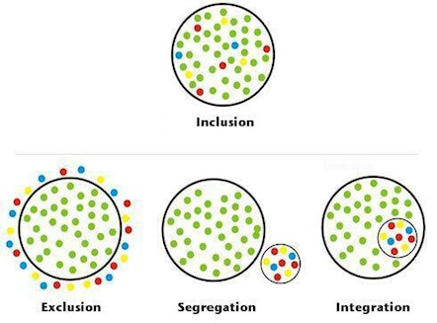

Slide 4
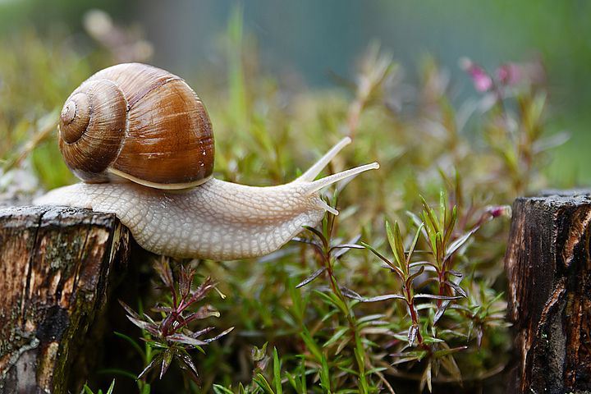

Slide 5
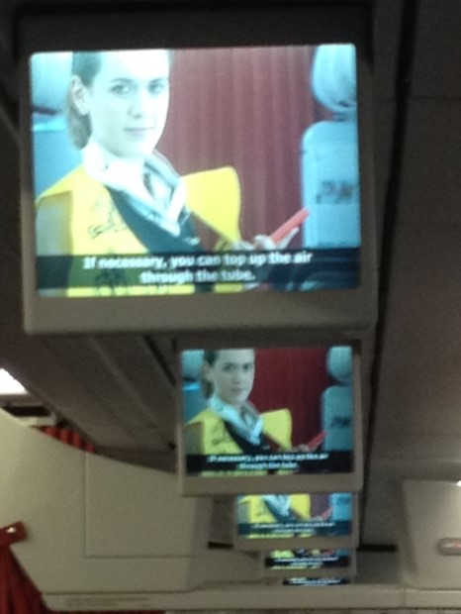
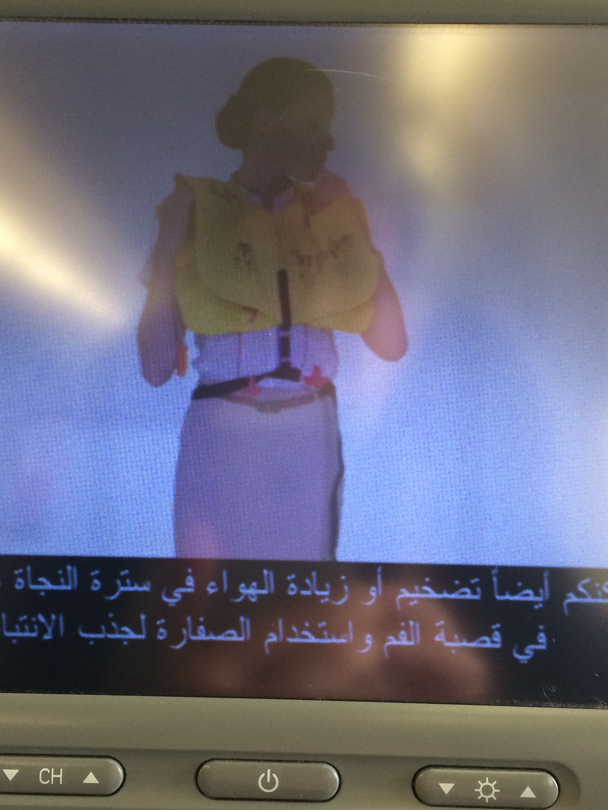
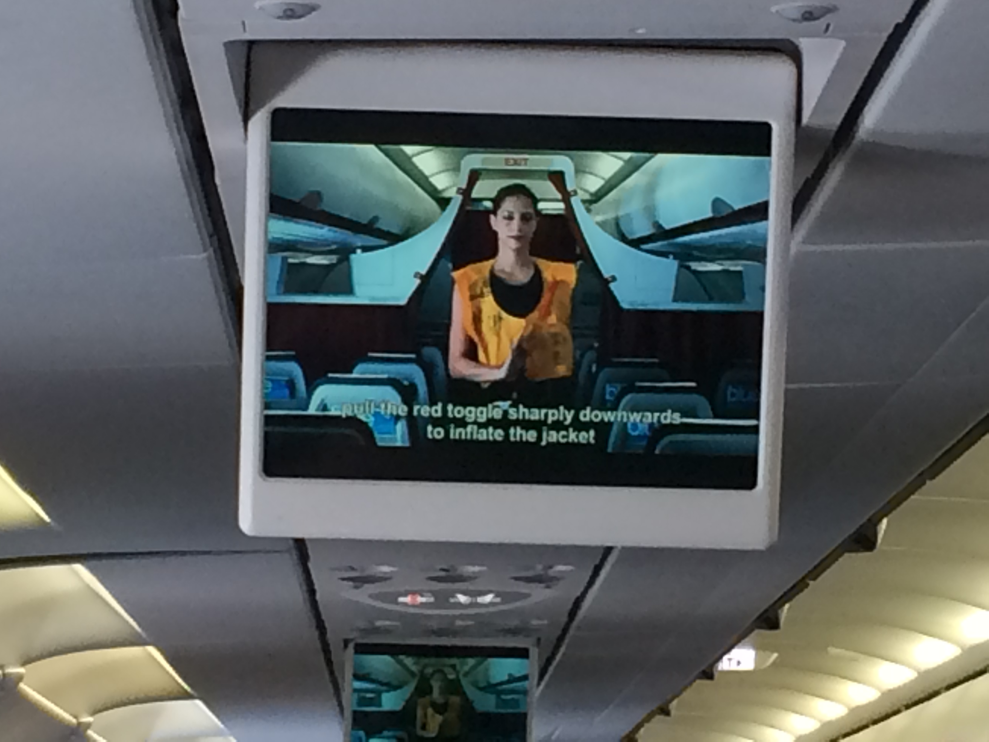

Slide 6
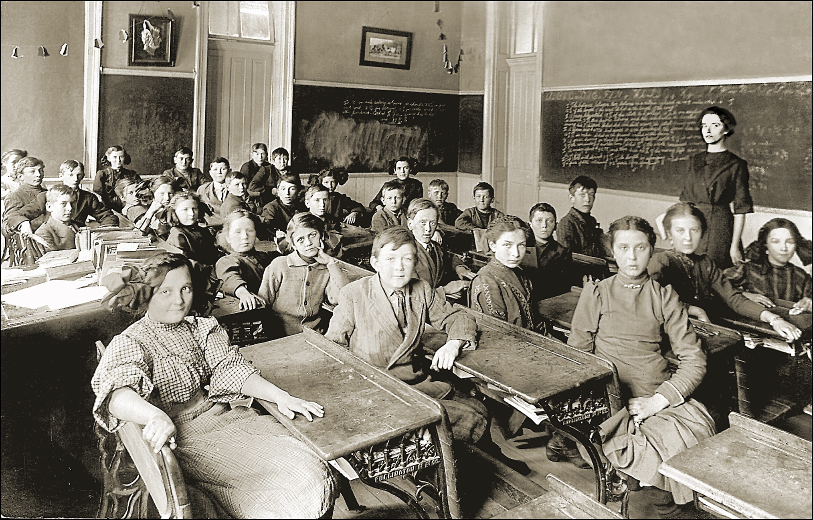

Slide 7
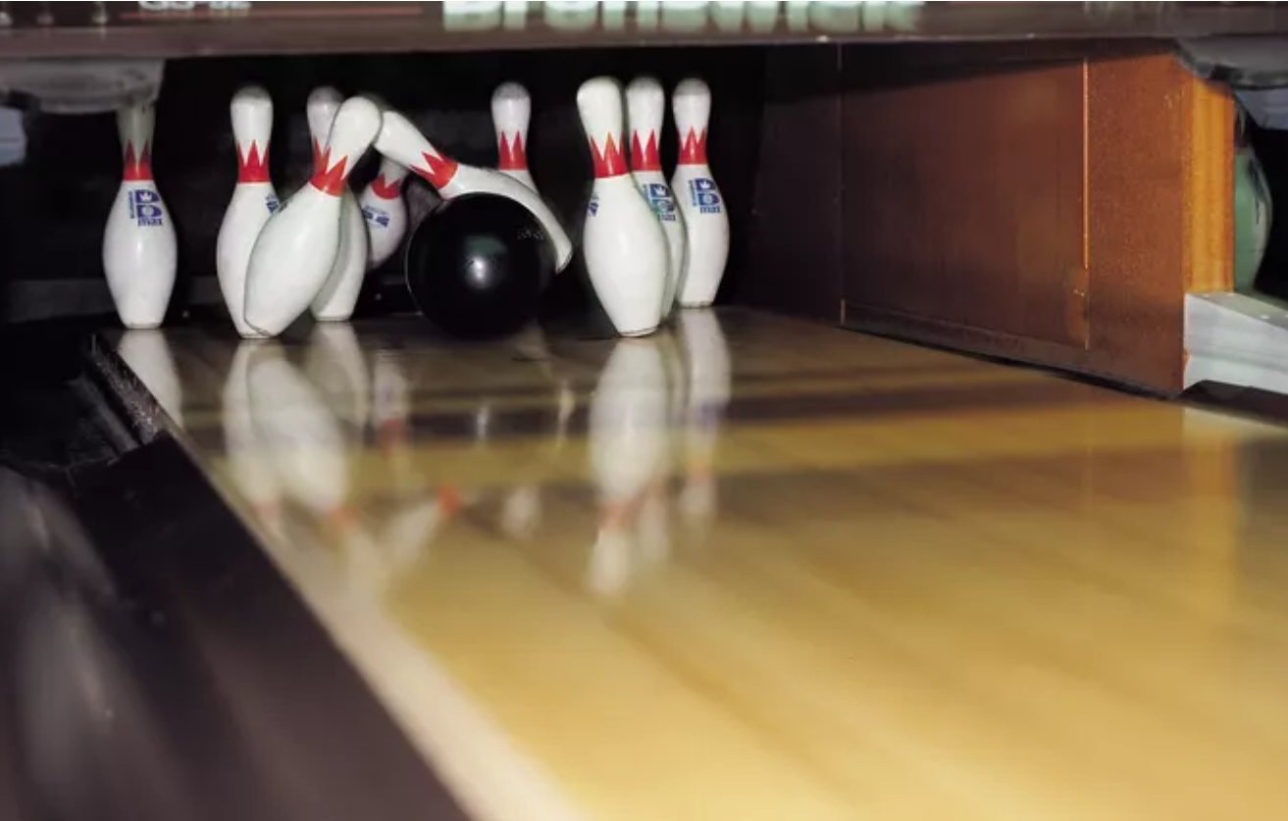

Slide 10
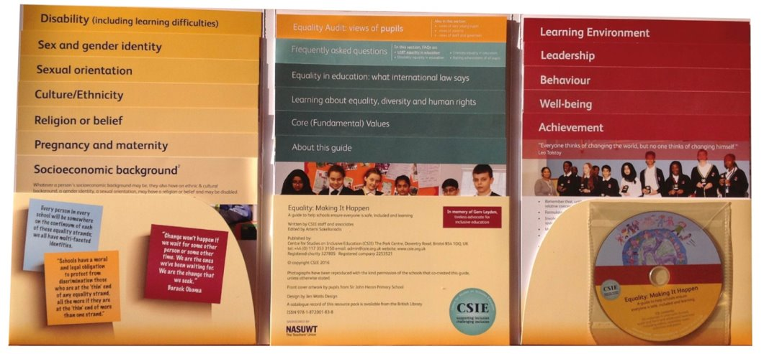

Slide 13
Thank you for your attention!
For more information:
Alana Institute - A Summary of the Evidence on Inclusive Education. https://bit.ly/evidence-inclusion
Council for Disabled Children – Disabled Children and the Equality Act https://bit.ly/CDC-Equality-Act-guide
CSIE - “Special” education revisited: https://bit.ly/CSIE-schools-story
Committee on the Rights of Persons with Disabilities (2016) CRPD/C/GC/4 General Comment no. 4 (2016) on the right to inclusive education. https://bit.ly/UNCRPD-GC4
UNESCO - A guide for ensuring inclusion and equity in education. https://bit.ly/UNESCOguide
UNCRC concluding observations: https://bit.ly/CRCJune2023, https://bit.ly/CRCJuly2016, https://bit.ly/CRCOctober2008
UNCRPD concluding observations: https://bit.ly/CRPDSept2017

